Slide 1

Transformer Based Surrogate Model for Radio Path Loss Prediction
Exploring Attention Mechanisms in RF Propagation
Presented by
Alex Punnen

Slide 2
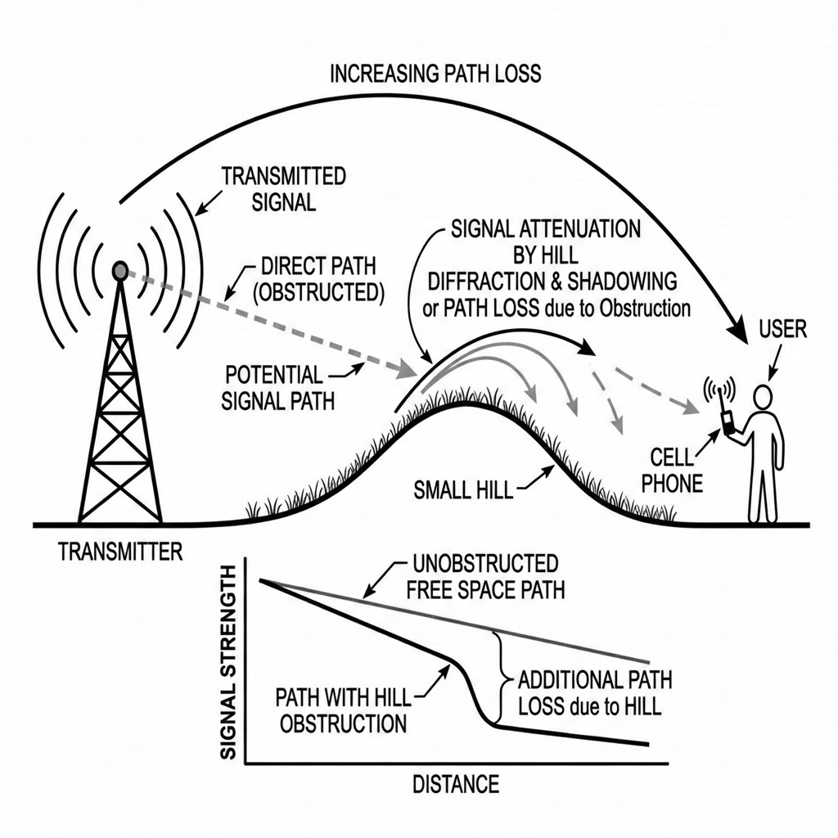
Context: Radio Pathloss
For Interference Mitigation (e.g, AFC 6GHz frequency coordination)
Efficient Spectrum Management and dynamic allocation (Link Budget)
Crucial for maximizing network coverage,data rate and capacity

Slide 3

Context Contd - ITM Path Loss Computations
A complex statistical model used for precision radio propagation prediction usually when Transmitter and Receiver are far off
CRITICAL INPUT PARAMETERS
AFC WIFI 6E APPLICATION
Elevation Profile: Detailed terrain data between transmitter and receiver.
Link Parameters: Frequency, antenna heights, and polarization settings.
Environmental Factors: Atmospheric conditions, climate, and ground conductivity.
Applied for distances up to 200 km to calculate interference with Microwave Transmitters.
CHALLENGE:
Requires massive elevation profile arrays and complex mathematical algorithms.
⚠️ ITM calculation is extremely compute-intensive due to statistical algorithm complexity and the large elevation data.

Slide 4
Idea: Using Transformer Model as a ITM surrogate
METHODOLOGY
OBJECTIVE & TARGET OUTCOMES
Utilize the Cross-Attention mechanism within a Transformer model structure.
Process complex elevation profile arrays as sequence data.
Analyze attention weights to find strong dependencies with output path loss.
Leverage Transformer attention mechanism for precise pathloss prediction.
Match: Accurate ITM pathloss calculations with reduced compute intensity.
Parallelize: Computation with GPU

Slide 5
Model Architecture - A Custom Transformer Model
INPUT PROCESSING
Elevation profile treated as a 1D sequence.
Linear layer projects values into high-dimensional embeddings (d_model).
SPATIAL AWARENESS
Sinusoidal positional encoding identifies terrain point locations along the path.
TRANSFORMER CORE
Encoder processes sequences using self-attention.
Scalar link features embedded as a single context token.
ATTENTION & PREDICTION
Cross-attention links scalar tokens to terrain positions.
Prediction head combines context for final path loss value.
https://github.com/alexcpn/elevation_transformer/blob/master/pathloss_transformer.py

Slide 6
Model Parameter Flow
Core Data Flow
Full Elevation Sequence TransformerEncoder X
Scalar Feature Linear Projection Y
X and Y Cross-Attention Layer One Scalar Output
Architectural Strategy
BERT-like Strategy: Uses an encoder-only transformer with full self-attention over the entire elevation sequence.
Applying cross-attention and an MLP head, the model predicts the final scalar path-loss value.
Model Summary: Sequence Processing via Cross-Attention

Slide 7
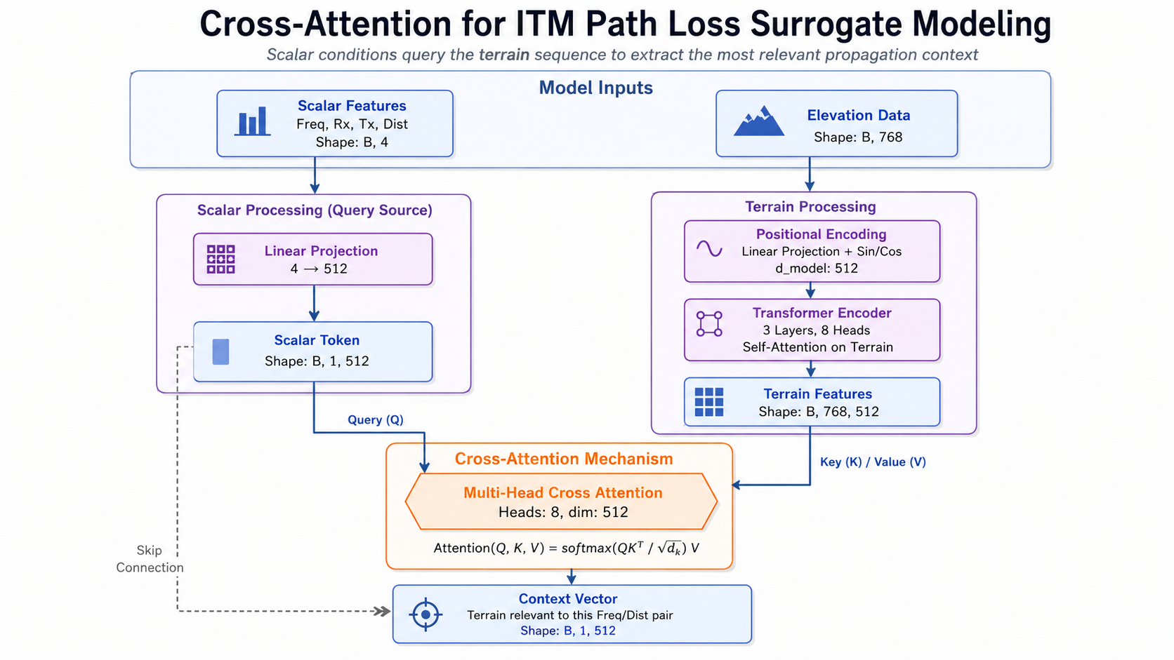

Slide 8
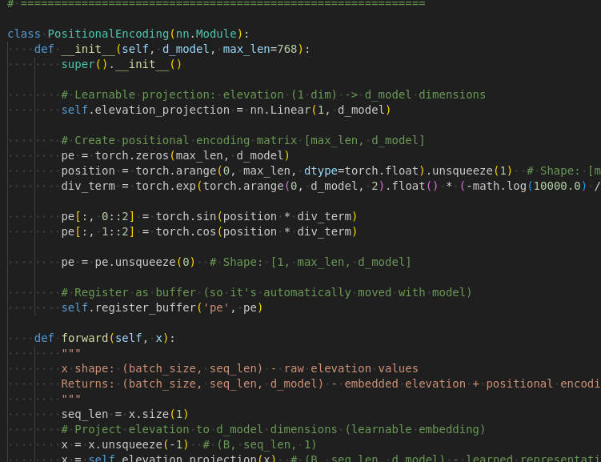
Details: Positional Encoding
IMPLEMENTATION DETAILS
The implementation utilizes the PyTorch NN module to define the model's spatial awareness component.
Sinusoidal Encoding: Injects relative position information into the terrain sequence.
1. Dimension Mapping: Projects input features into d_model=512 embedding space. (B, 768) -> (B, 768, 512) (This 512 is learnable)
2. Add Position Vector:(1,768,512) this is one time calculated non trainable: Broadcast
Think of it as adding a 512 position signal to each elevation point (see forward pass)
View Full Implementation on GitHub
Notes:
elevation_data: (B, 768)
after unsqueeze: (B, 768, 1)
after linear embedding:
elevation_embedding: (B, 768, 512)
positional encoding:
pe: (1, 768, 512)
after broadcasting:
pe: (B, 768, 512)
final terrain tokens:
elevation_embedding + pe = (B, 768, 512)

Slide 9
Details: Elevation Encoding and Cross Attention
KEY ARCHITECTURAL COMPONENTS
Elevation values are projected into transformer embeddings.
Positional encoding tells the model where each terrain point is located.
Transformer self-attention processes the full terrain sequence.
Link parameters are embedded as a scalar context token.
Cross-attention lets link parameters attend to relevant terrain positions.
Final head predicts one path loss value.
class PathLossModel(nn.Module):
def __init__(self):
super().__init__()
# ... configuration ...
self.pos_encoding = PositionalEncoding(d_model, seq_len)
self.transformer = nn.TransformerEncoder(layer, layers)
self.cross_attention = nn.MultiheadAttention(d_model, heads)
self.head = nn.Sequential(nn.Linear(d_model*2, 256), ...)
def forward(self, features, elevation, mask=None):
# 1. Embed Scalars & Terrain
s_token = self.extra_features_embedding(features).unsqueeze(1)
pos_tokens = self.pos_encoding(elevation)
# 2. Self & Cross Attention (approx)
context, _ = self.cross_attention(query=pos_token, key=elevation_features, value=elevation_features, key_padding_mask=mask)
# 3. Fuse & Predict
fused = torch.cat([s_token, context], dim=-1)
return self.head(fused).squeeze()

Slide 10
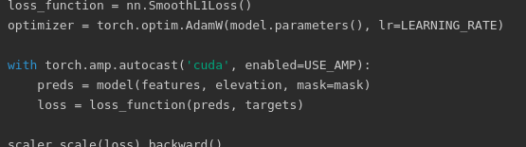
Model Training
Trained on over 7.8 million ITM-generated samples spanning the 6 GHz band with distances from 1.3 to 200 km across diverse terrain types.
DATASET & PREPROCESSING
OPTIMIZATION
Provides terrain profiles, link features, and ITM target loss.
Elevation profiles padded/truncated to fixed length.
Sample-wise elevation normalization for stability.
Scalar feature normalization for mixed precision.
Padding masks prevent attention on fake positions.
Loss: Smooth L1 loss.
Optimizer: AdamW.
Precision: Mixed precision for speed and GPU memory.
Trained on Cloud GPUs (RunPod) using Nvidia RTX 2000 and RTX 5090 16/32GB 6vCPU 1 Epoch

Slide 11
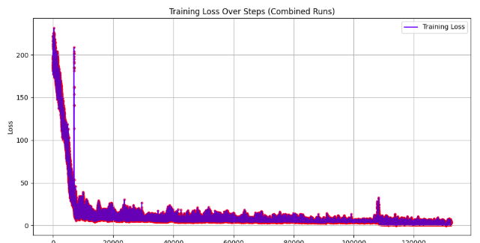
Training Result
Note: It took close to a year and multiple trial and error to reach here. Still not optimal.
LOSS CURVE ANALYSIS
Figure 2: Training loss over ~130k steps.
Rapid Learning (0-10k): Loss drops ~230 → ~10 as model learns terrain relationships.
Plateau (10k-130k): Oscillates between 3-10; suggests learning rate is too high.
Improvements: The much higher MAE, RMSE, 90th and 95th percentile errors
show a heavy tail, where a minority of
cases have large prediction errors.
ERROR METRICS
RMSE: 17.85 dB Root Mean Square Error - shows the typical error magnitude, but penalizes large errors more heavily - outliers
MAE: 10.94 dB Mean Absolute Error (Simple Average)
Median Error: 5.00 dB Indicates 50% of results are in a respectable range
90th Percentile: 31.02 dB 10% have 31 dB or more error
95th Percentile: 41.59 dB 5% have 41.59 dB or more error

Slide 12
Conclusion
Architecture Validation
The overall intuition of the model architecture seems correct based on the observed training loss trends.
Areas for Improvement
Continuous refinements are necessary across two primary vectors:
Model Refinement: Enhancing internal logic and parameters.
Data Quality: Optimizing generated training data for better coverage.
Next Steps
Planned experimentation focusing on scaling the transformer architecture:
Increasing model depth for complex pattern recognition.
Expanding the number of attention heads.
Iterative testing of new hyperparameters.

